Slide 1
Asset Tracking through RFID
Challenges
Asset Tracking common pitfalls
Proposed RFID Solutions
Benefits of Stallion RFID Solution
ASSET MANAGEMENT
Prepared by Stallion systems & solutions Pvt Ltd
Private and Confidential

Slide 2
What is Die Casting
Die casting is a metal casting process in which molten metal is forced into a steel mold under high pressure into a mold cavity. The steel molds, known as dies, are fabricated to produce castings with intricate shapes in a manner that insures both accuracy and repeatability.

Slide 3
Challenges
J D Jones Pvt ltd are manufacturers of fluid sealing & packing solutions. In their manufacturing process, they use a lot of Dies. They have a system of stacking them, they require a solution for storing these Dies in a systematic manner, so that we can efficiently pull out the dies as and when required and again be able to stack them when not in use. All Dies are mostly made up of MS/D2 etc., Iron body, circular and rectangular in shape. They cannot stick any paper based Tags, as they won’t stay, since Dies go through various handling stages, involving, oil, grease, graphite powder etc.

Slide 4
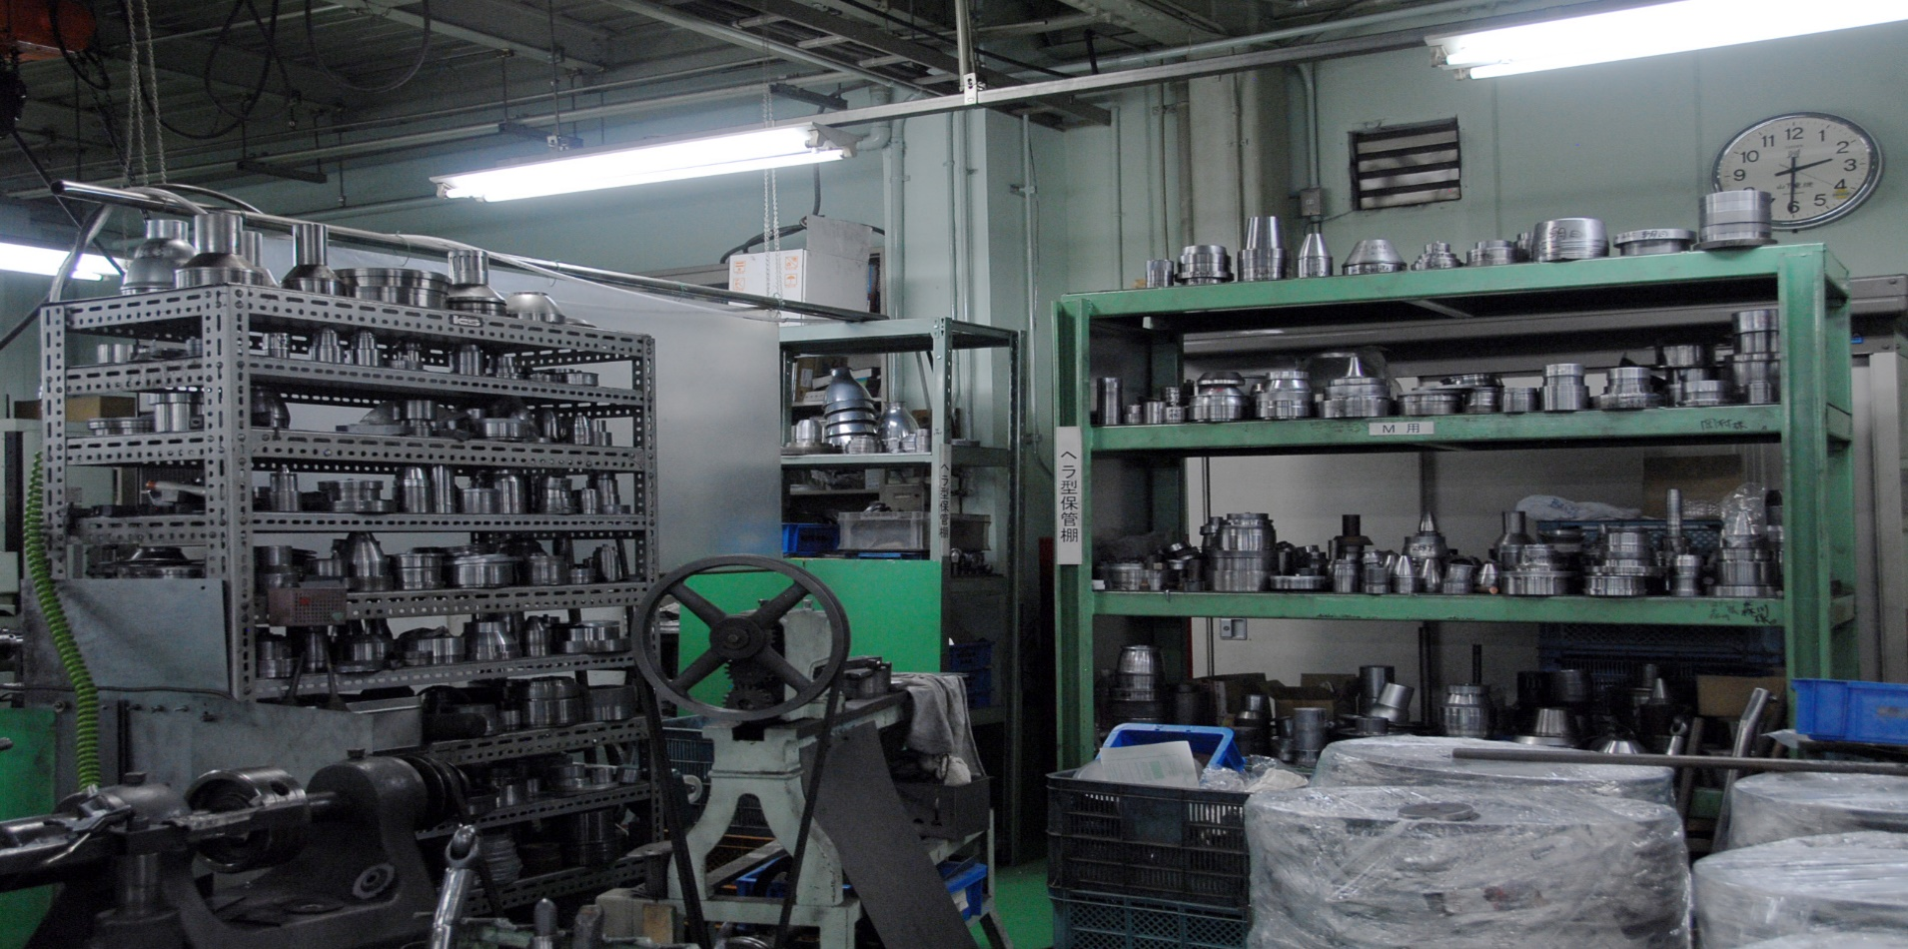
Store Room Before RFID Solutions

Slide 5
Asset Tracking – The common pitfalls
  Manual methods are labor-intensive and subject to error. And with highly valued, highly compensated employees, introducing intrusive methods of asset tracking only serve to reduce productivity and slow the organization’s workflow.
  Prone to mis-identification and duplication of the assets.
  Extremely time consuming.
  No proper visibility to the management on the number and type of assets
  Poor control over the movements of the critical mobile assets.
  Poor Asset management can threaten the accuracy or critical financial reports resulting in re-reporting and negatively impacting the bottom line.
Private and Confidential

Slide 6
Proposed RFID Solution
Passive UHF RFID tags are applied in a plastic jacket & Label will be pasted on this jacket for physical identification of assets and tied it with thread. RFID printer & HHT barcode scanner will be applicable if asset quantity will be higher.
Each tag will have a unique ID which will be the identifier of the asset. And this will be used for getting all the relevant details about the asset from the asset database.
An asset can be searched by keying in the Asset ID in the hand-held terminal and reading the probable assets. When the keyed Asset ID matches with the read RFID tag on an asset, the terminal beeps indicating that asset has been found. A message can also be pop up in the terminal display indicating the result of search.
Private and Confidential

Slide 7
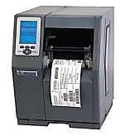
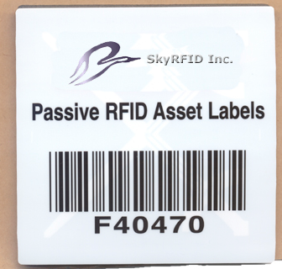
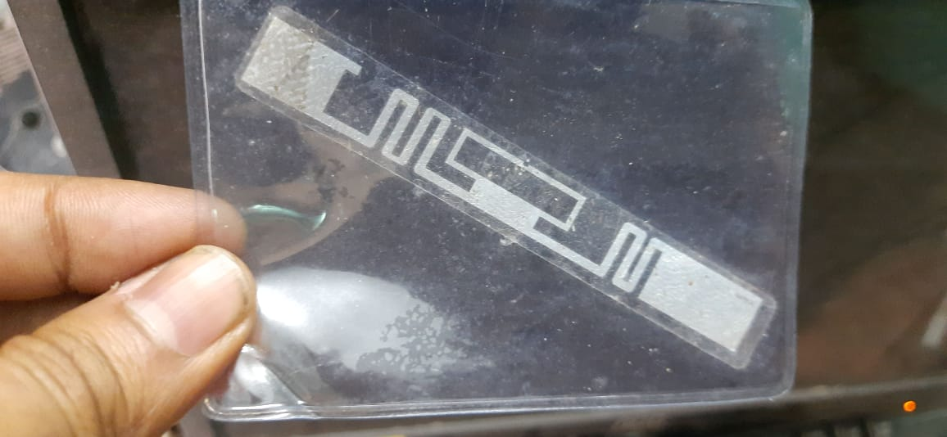

Proposed RFID Solution
Asset Registration Process
Tag Registration & Printing
Tag & Fixing Mechanism
Registered Tag Affixed On Asset
Private and Confidential

Slide 8
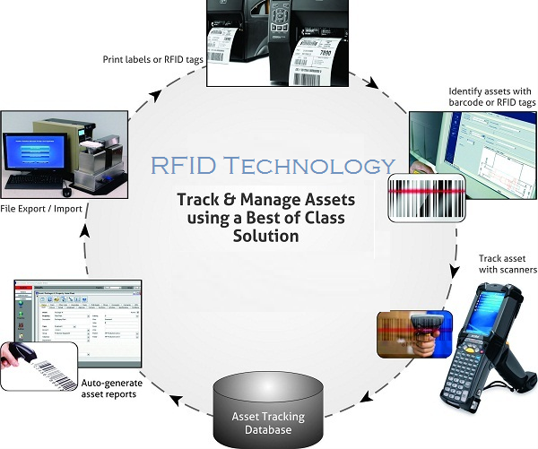
Proposed RFID Solutions

Slide 9
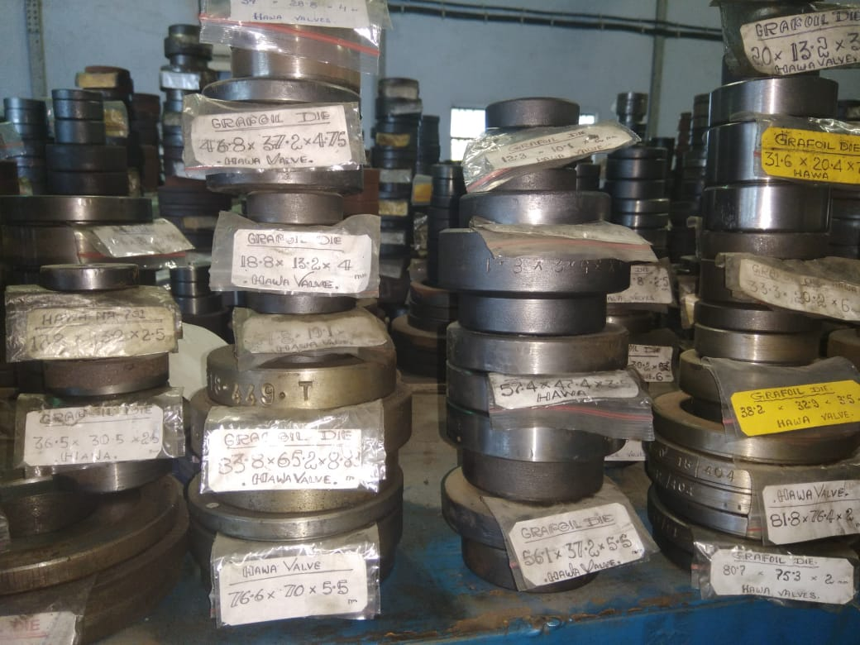
Store Room after RFID tagging

Slide 10
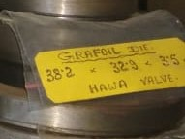
RFID Label

Slide 11
Benefits of RFID Solution
Benefit of RFID based asset Tracking
Monitoring and tracking Asset movement.
Better Asset visibility and Asset utilization.
Quick allocation of Assets and immediate update on their status.
Identification of the deviations from expected Asset location or condition.
Generation of trigger/exception based alerts or specific warning notifications.
Maintenance of Asset inventories and validation of the Asset utilization.
Private and Confidential

Slide 12
Thank You
In case of any queries, contact us at
debraj@stallionindia.com
Ph: 9831364678
Private and Confidential

